Slide 1

FPT University
Android programMing
Lesson 4
Version 1.0

Slide 2
Agenda
Manually Creating an XML Layout
Managing Constraints using Constraint Sets
An Overview and Example of Android Event Handling
A Guide to using Instant Run in Android Studio

Slide 3
Manually Creating an XML Layout
Manually Creating an XML Layout
<?xml version="1.0" encoding="utf-8"?> <android.support.constraint.ConstraintLayout xmlns:android="http://schemas.android.com/apk/res/android" xmlns:app="http://schemas.android.com/apk/res-auto" xmlns:tools="http://schemas.android.com/tools" android:layout_width="match_parent" android:layout_height="match_parent" android:paddingLeft="16dp" android:paddingRight="16dp" android:paddingTop="16dp" android:paddingBottom="16dp" tools:context=".Main3Activity"> </android.support.constraint.ConstraintLayout>

Slide 4
Manually Creating an XML Layout
in – Inches
mm – Millimeters
pt – Points (1/72 of an inch)
dp – Density-independent pixels. An abstract unit of measurement based on the physical density of the device display relative to a 160dpi display baseline.
sp – Scale-independent pixels. Similar to dp but scaled based on the user’s font preference.
px – Actual screen pixels. Use is not recommended since different displays will have different pixels per inch. Use dp in preference to this unit.
Notes:
device-independent pixel

Slide 5
Manually Creating an XML Layout
<TextView android:id="@+id/textView4" android:layout_width="wrap_content" android:layout_height="wrap_content" android:layout_marginStart="8dp" android:layout_marginTop="8dp" android:layout_marginEnd="8dp" android:layout_marginBottom="8dp" android:text="Price : 1000$" android:textSize="30sp" app:layout_constraintBottom_toBottomOf="parent" app:layout_constraintEnd_toEndOf="parent" app:layout_constraintHorizontal_bias="0.086" app:layout_constraintStart_toEndOf="@+id/imageView4" app:layout_constraintTop_toTopOf="parent" app:layout_constraintVertical_bias="0.109" />

Slide 6
Manually Creating an XML Layout
<Button android:id="@+id/button" android:layout_width="wrap_content" android:layout_height="wrap_content" android:layout_marginStart="8dp" android:layout_marginTop="8dp" android:layout_marginEnd="8dp" android:layout_marginBottom="8dp" android:text="Button" app:layout_constraintBottom_toBottomOf="parent" app:layout_constraintEnd_toEndOf="parent" app:layout_constraintStart_toStartOf="parent" app:layout_constraintTop_toTopOf="parent" />

Slide 7
Manually Creating an XML Layout
Manual XML vs. Visual Layout Design
Design mode is more advantage but in case the view not is common view, design mode is useless.
Design mode | XML mode
Quick | Slow
Easy | Complex

Slide 8
Managing Constraints using Constraint Sets
Java Code vs. XML Layout Files
Button button = new Button(this); button.setId(View.generateViewId()); ConstraintLayout myLayout = findViewById(R.id.myLayout); button.setText("Click here"); myLayout.addView(button);

Slide 9
Managing Constraints using Constraint Sets
Constraint Sets
constraint sets are used to control how a view appears relative to its parent view and other sibling views
ConstraintSet constraintSet = new ConstraintSet(); constraintSet.connect(button.getId(),ConstraintSet.RIGHT, ConstraintSet.PARENT_ID,ConstraintSet.RIGHT); constraintSet.connect(button.getId(),ConstraintSet.LEFT, ConstraintSet.PARENT_ID,ConstraintSet.LEFT); constraintSet.connect(button.getId(),ConstraintSet.TOP, ConstraintSet.PARENT_ID,ConstraintSet.TOP); constraintSet.connect(button.getId(),ConstraintSet.BOTTOM, ConstraintSet.PARENT_ID,ConstraintSet.BOTTOM); constraintSet.applyTo(myLayout);

Slide 10
Managing Constraints using Constraint Sets
Set Width and Heigh
constraintSet.constrainWidth(button.getId(), ConstraintSet.WRAP_CONTENT); constraintSet.constrainHeight(button.getId(), ConstraintSet.WRAP_CONTENT);

Slide 11
Managing Constraints using Constraint Sets
Set margin
Bias constraint
constraintSet.connect(button.getId(), ConstraintSet.LEFT, ConstraintSet.PARENT_ID, ConstraintSet.LEFT, 200); constraintSet.connect(button.getId(), ConstraintSet.TOP, ConstraintSet.PARENT_ID, ConstraintSet.TOP, 200);
constraintSet.setHorizontalBias(button.getId(), 0.25f); constraintSet.setVerticalBias(button.getId(), 0.25f);

Slide 12
An Overview and Example of Android Event Handling
Understanding Android Events
Generated in response to an external action
Android framework maintains an event queue into which events are placed as they occur
In order to handle the event, the view must have in place an event listener

Slide 13
An Overview and Example of Android Event Handling
Using callback declaration
button.setOnClickListener(new Button.OnClickListener() { public void onClick(View v) { //-------------------TO DO ------------------------ } });

Slide 14
An Overview and Example of Android Event Handling
Using the android:onClick Resource
<Button android:id="@+id/button1" android:layout_width="wrap_content" android:layout_height="wrap_content" android:onClick="buttonClick" android:text="Click me" />

Slide 15
An Overview and Example of Android Event Handling
Event Listeners and Callback Methods
onClickListener()
onLongClickListener()
onTouchListener()
onFocusChangeListener()
Notes:
onClickListener – Used to detect click style events whereby the user touches and then releases an area of the device display occupied by a view. Corresponds to the onClick() callback method which is passed a reference to the view that received the event as an argument.
· onLongClickListener – Used to detect when the user maintains the touch over a view for an extended period. Corresponds to the onLongClick() callback method which is passed as an argument the view that received the event. · onTouchListener – Used to detect any form of contact with the touch screen including individual or multiple touches and gesture motions. Corresponding with the onTouch() callback, this topic will be covered in greater detail in the chapter entitled Android Touch and Multi-touch Event Handling. The callback method is passed as arguments the view that received the event and a MotionEvent object. · onCreateContextMenuListener – Listens for the creation of a context menu as the result of a long click. Corresponds to the onCreateContextMenu() callback method. The callback is passed the menu, the view that received the event and a menu context object.
· onFocusChangeListener – Detects when focus moves away from the current view as the result of interaction with a track-ball or navigation key. Corresponds to the onFocusChange() callback method which is passed the view that received the event and a Boolean value to indicate whether focus was gained or lost. · onKeyListener – Used to detect when a key on a device is pressed while a view has focus. Corresponds to the onKey() callback method. Passed as arguments are the view that received the event, the KeyCode of the physical key that was pressed and a KeyEvent object.
https://developer.android.com/reference/android/view/View.OnKeyListener

Slide 16
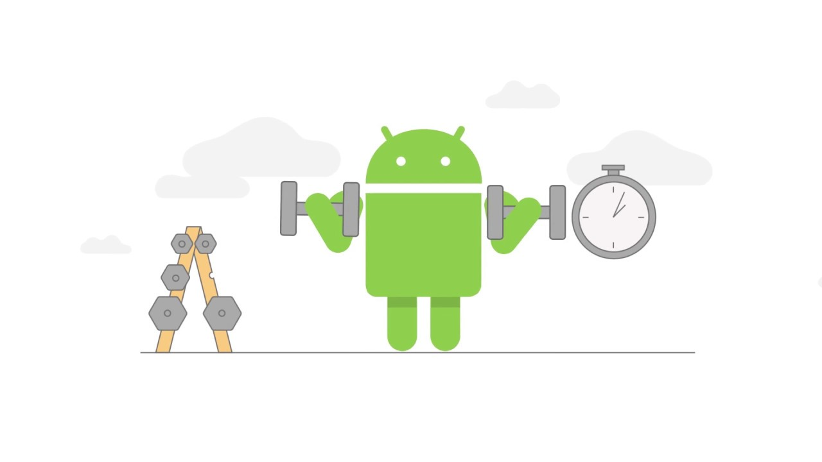
An Overview and Example of Android Event Handling
An Event Handling Example

Slide 17
An Overview and Example of Android Event Handling
onFocusChangeListener()
final EditText editText = findViewById(R.id.editText); editText.setOnFocusChangeListener(new View.OnFocusChangeListener() { @Override public void onFocusChange(View v, boolean hasFocus) { if(hasFocus){ if(((EditText) v).getText().toString().equals("Name")){ ((EditText) v).setTextColor(Color.argb(255,0,0,0)); ((EditText) v).setText(""); } }else { if(((EditText) v).getText().toString().isEmpty()){ ((EditText) v).setText("Name"); ((EditText) v).setTextColor(Color.argb(255,200,200,200)); } } } });
Notes:
Implement a placeholder for a edit text

Slide 18
An Overview and Example of Android Event Handling
Consuming Events How android system manage if one view register two event?
button.setOnClickListener(new Button.OnClickListener() { public void onClick(View v) { TextView editText = findViewById(R.id.editText); TextView text = findViewById(R.id.textView); text.setText("Hello " + editText.getText()); Toast.makeText(MainActivity.this, "Hello " + editText.getText(), Toast.LENGTH_LONG).show(); } }); button.setOnLongClickListener( new Button.OnLongClickListener() { public boolean onLongClick(View v) { TextView statusText = (TextView)findViewById(R.id.editText); statusText.setText("Long button click"); return true; } } );
Notes:
The purpose of this return value is to indicate to the Android runtime whether or not the callback has consumed the event. If the callback returns a true value, the event is discarded by the framework. If, on the other hand, the callback returns a false value the Android framework will consider the event still to be active and will consequently pass it along to the next matching event listener that is registered on the same view.

Slide 19

A Guide to using Instant Run in Android Studio
Introducing Instant Run
Instant Run allows code and resource changes within a project to be reflected nearly instantaneously within the app while it is already running on a device or emulator session.
Notes:
Consider, for the purposes of an example, an app being developed in Android Studio which has already been launched on a device or emulator. If changes are made to resource settings or the code within a method, Instant Run will push the updated code and resources to the running app and dynamically “swap” the changes. The changes are then reflected in the running app without the need to build, deploy and relaunch the entire app. In many cases, this allows changes to be tested in a fraction of the time it would take without Instant Run.

Slide 20
A Guide to using Instant Run in Android Studio
Understanding Instant Run Swapping Levels
Hot Swapping
Warm Swapping
Cold Swapping
Notes:
Hot Swapping – Hot swapping occurs when the code within an existing method implementation is changed. The new method implementation is used next time it is called by the app. Warm Swapping – When a change is made to a resource file of the project, an Instant Run warm swap is performed. A warm swap involves the restarting of the currently running activity.
Cold Swapping – Structural code changes such as the addition of a new method, a change to the signature of an existing method or a change to the class hierarchy of the project triggers a cold swap in which the entire app is restarted. In some conditions, such as the addition of new image resources to the project, the application package file (APK) will also be reinstalled during the swap

Slide 21
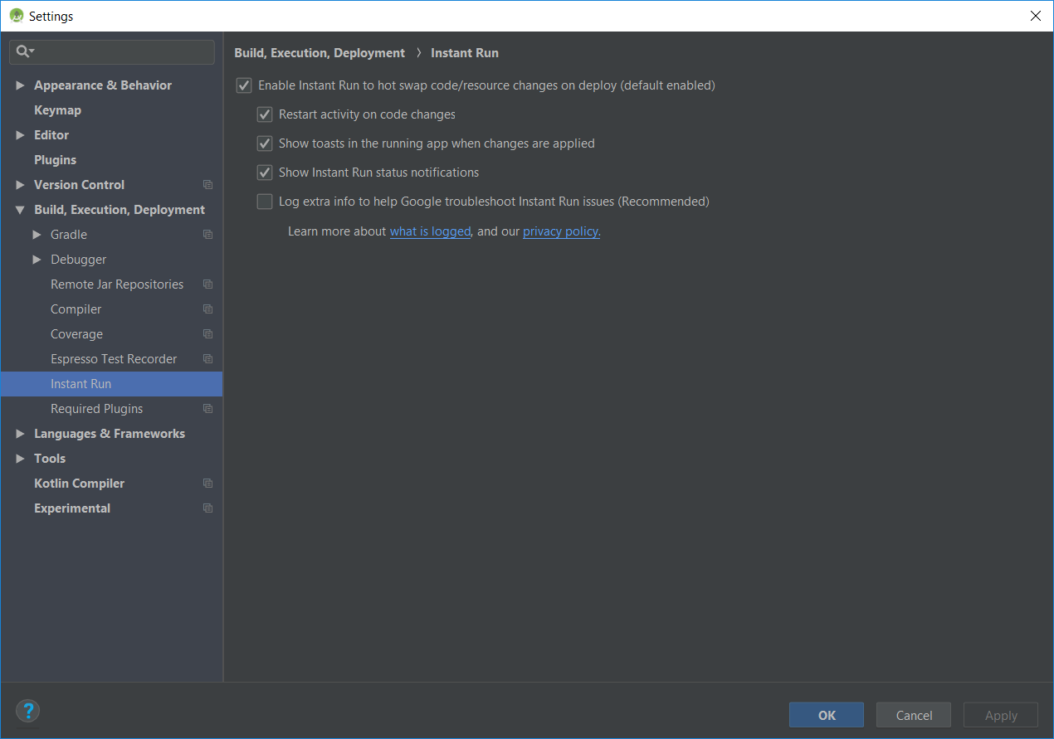
A Guide to using Instant Run in Android Studio
Enabling and Disabling Instant Run

Slide 22

A Guide to using Instant Run in Android Studio
Using Instant Run
Normal launch at 1st time
After the app has launched and is running, Android Studio will indicate the availability of Instant Run by enabling the Apply Changes

Slide 23
A Guide to using Instant Run in Android Studio
Triggering an Instant Run Hot Swap
Triggering an Instant Run Warm Swap
Triggering an Instant Run Cold Swap

Slide 24

End of Lesson 4

Slide 25
Thank you!

